Slide 1

Cars66
By Eniya vignesh

Slide 2
Problem Statement
Admin Flow:
Admins can add a new product with full information about the product.
Admins can edit if the product have any changes and delete the product if the product is removed.
User Flow:
The user can login and check the products that have been listed on the user's home page.
Users can see the product details with pictures.and can see the product reviews,details.

Slide 3
Requirements
An angular material is used.
Using pipes, Typefilter is done.
Using lazy loading, the login/logout function is done.
Using service calls (Get, Post, Update, Delete) these operations are done.
Using Routing concept, to navigate one page to another page.

Slide 4
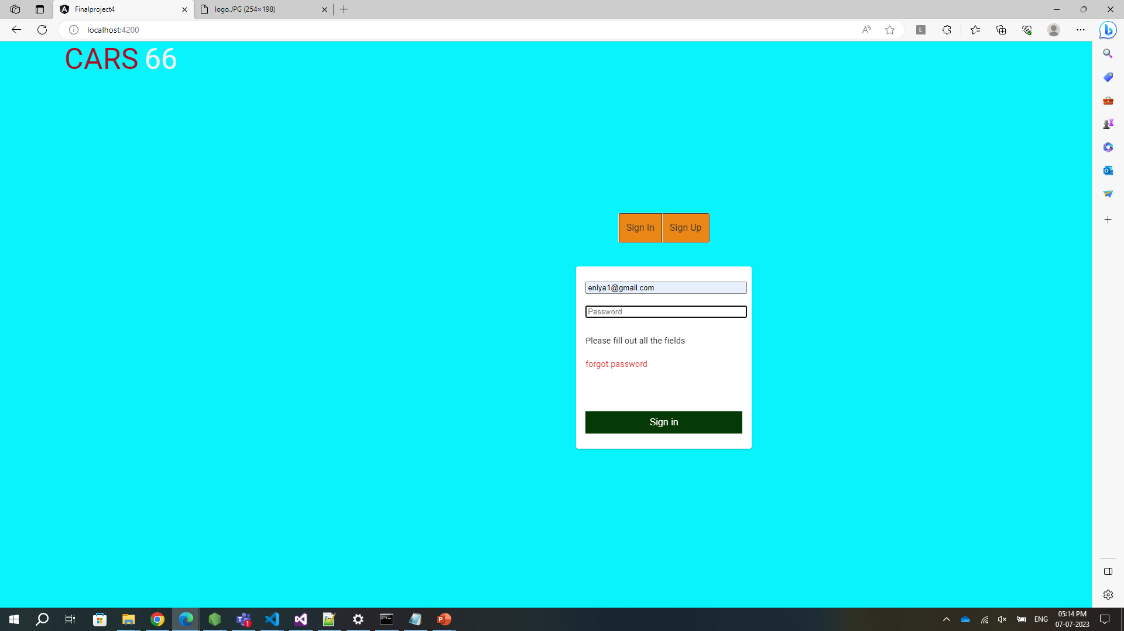
Login Page
We can log in by admin login and user login

Slide 5
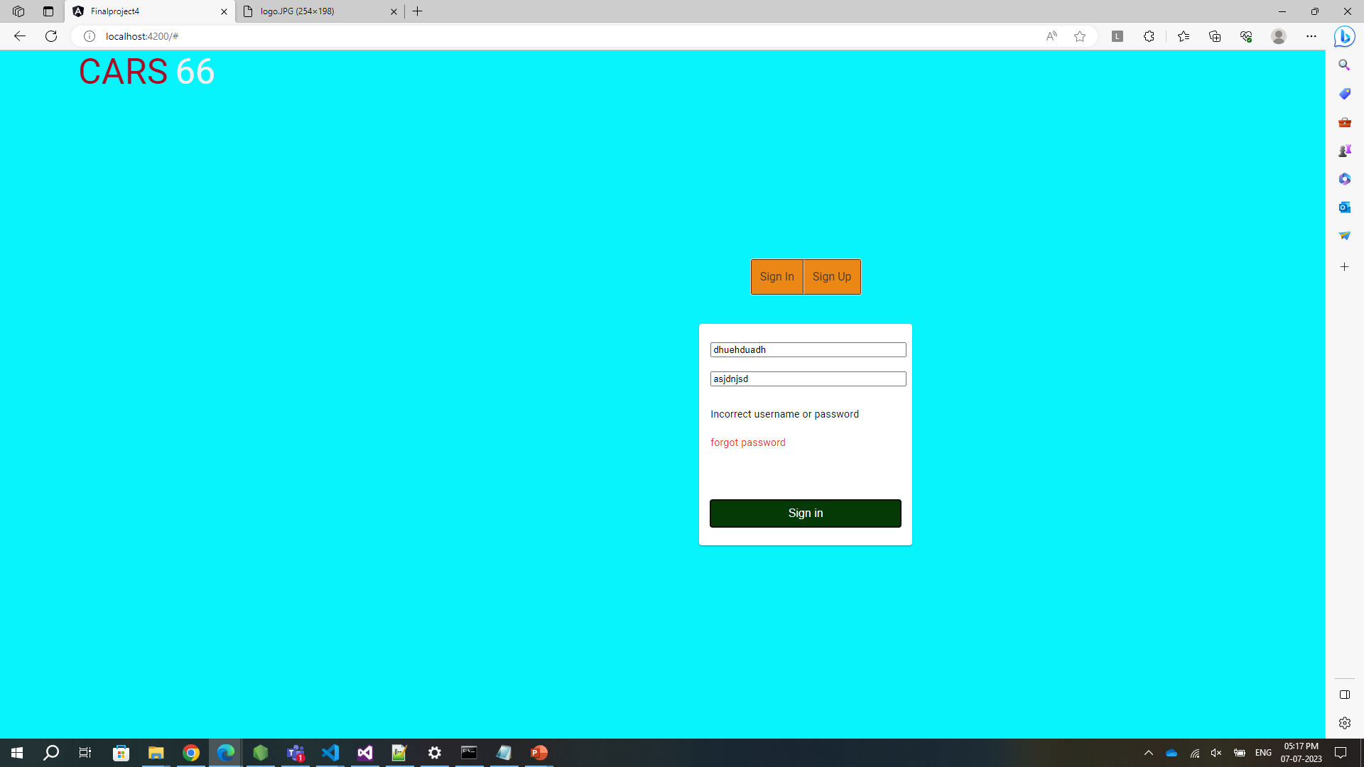
Login Screen
If the Administrator or User doesn’t enter the login credential and tries to login, an incorrect message will be shown asking them to fill out all the details in the form.

Slide 6
In Log in page
If we click ok in warring message box it will go to admin home or user home page

Slide 7
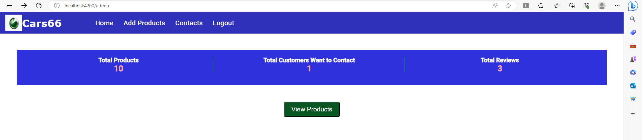
If we click add products.

Slide 8
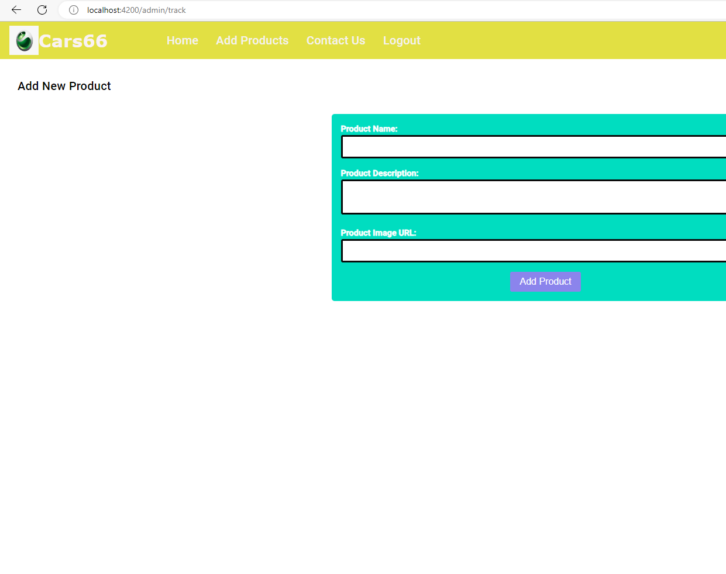
Admin can add new products by clicking add product.

Slide 9
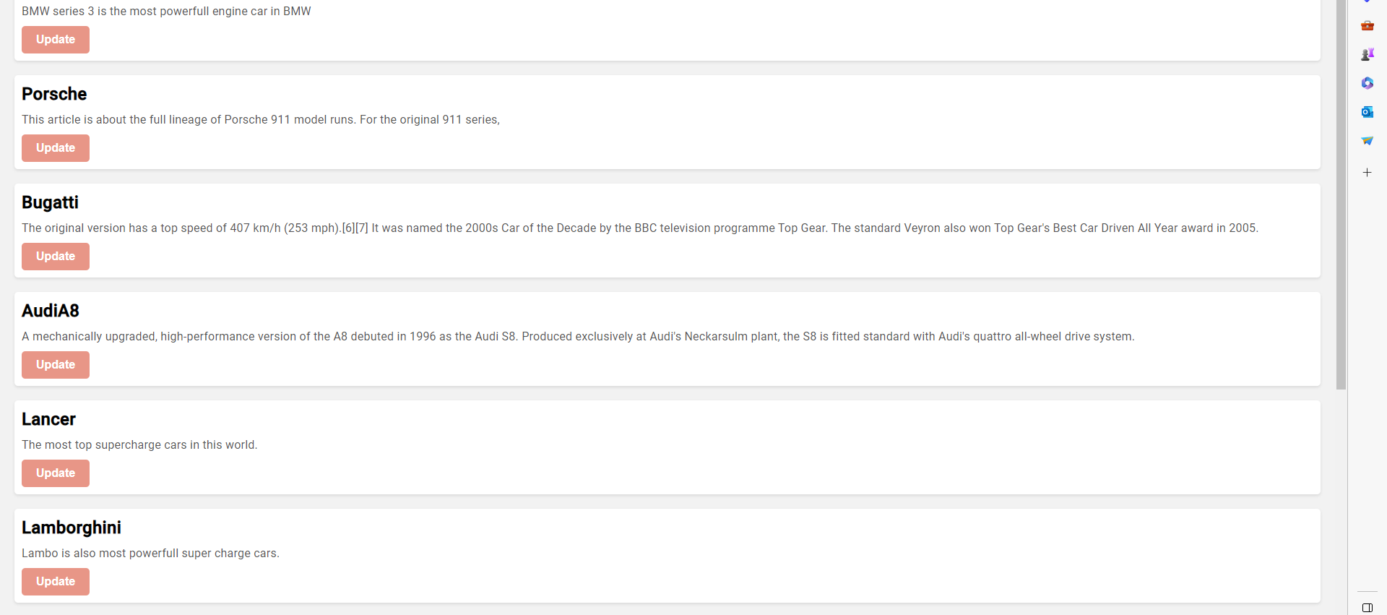
In admin user log in: We can update or change the details by clicking view products in home page.

Slide 10
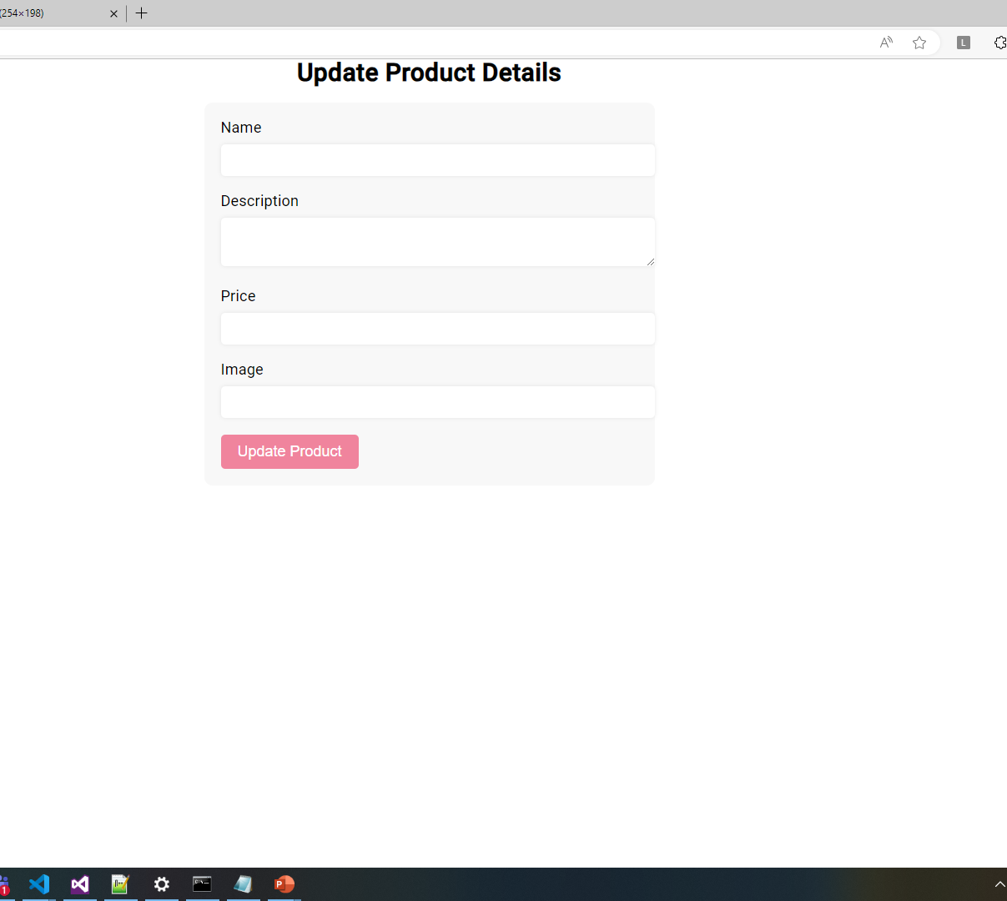
We can update a product by clicking update product

Slide 11
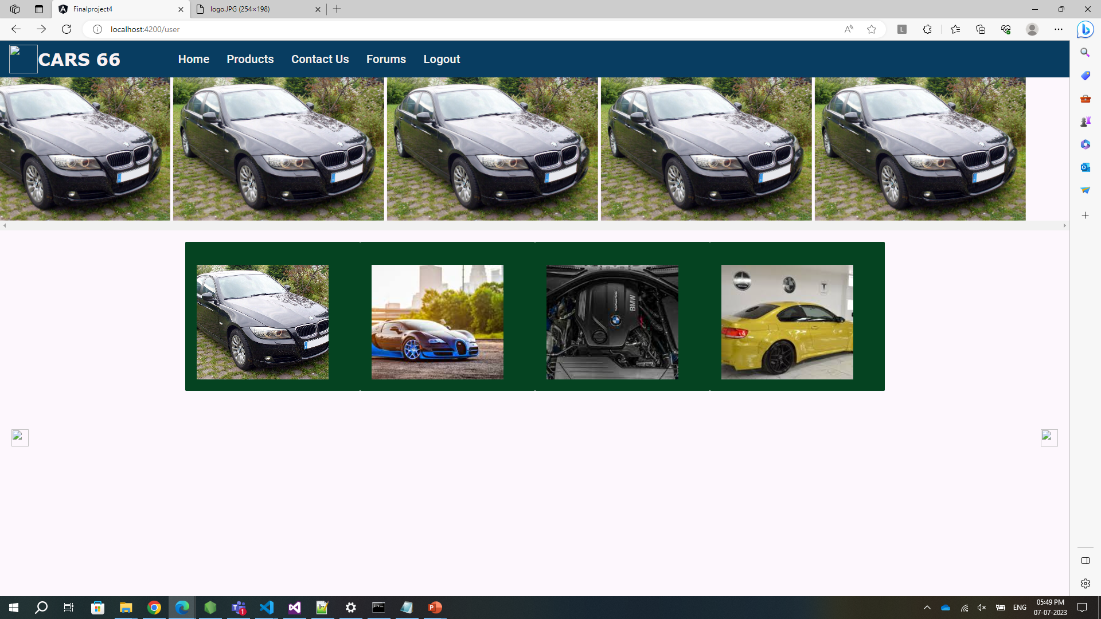
We can log in using user log in id and password. Then the user home page will launch.

Slide 12
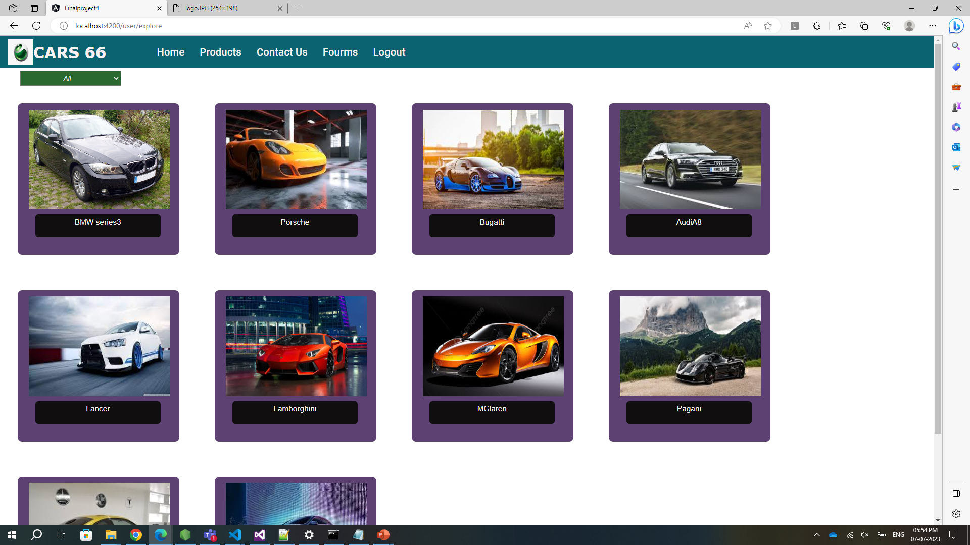
We can launch products page by clicking products menu in header

Slide 13
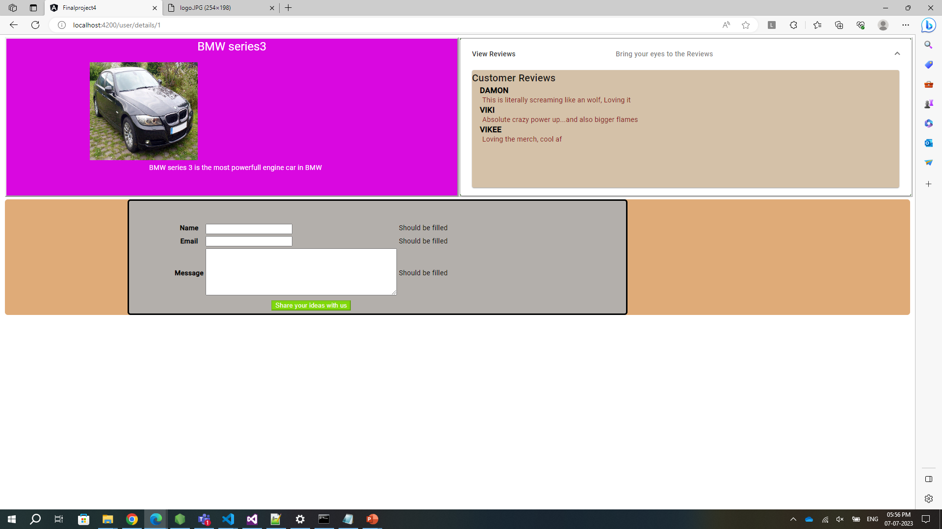
If we click 1st product the we see view reviews drop down in that we can see reviews. And we can share our ideas.

Slide 14
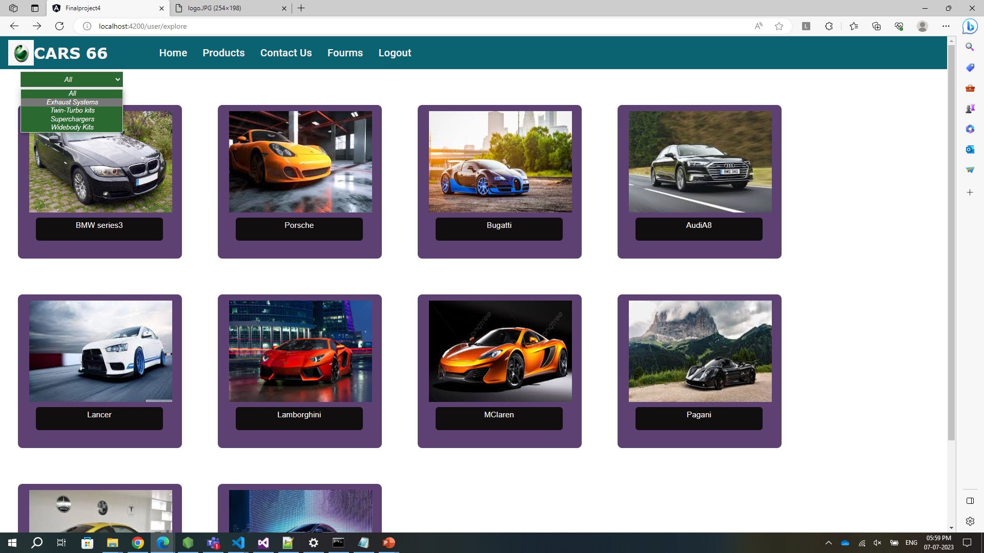
We can see products spec by clicking drop down menu.

Slide 15
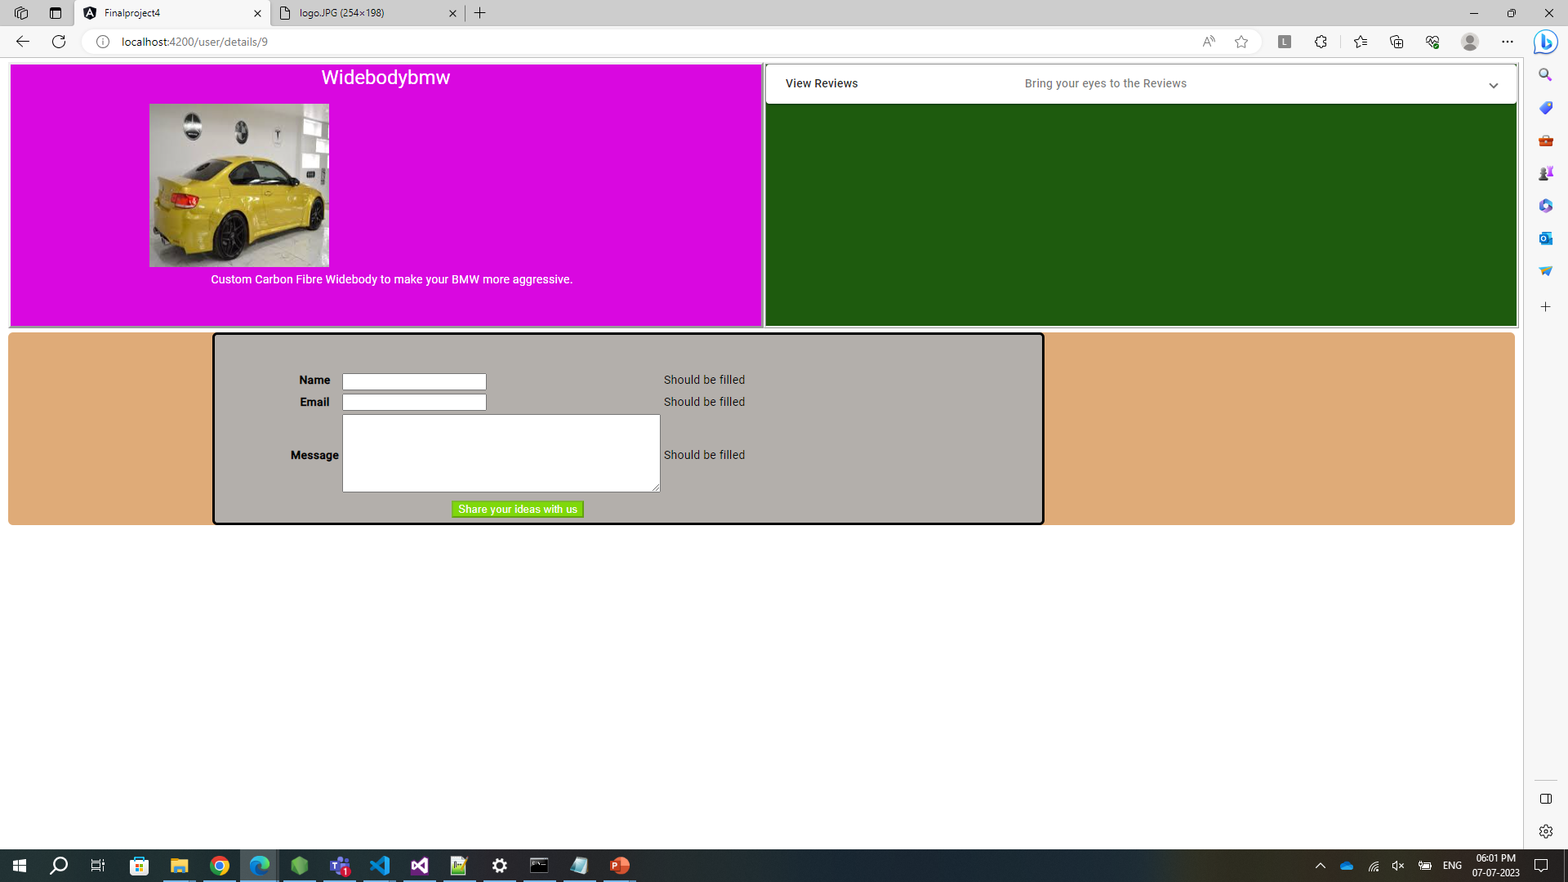
We can we body specs by clicking drop down menu in product page

Slide 16
Thank you

